Slide 1
DIGITAL ANTI-GLARE GOGGLE
TEAM MEMBERS
SHARMITHA.G
SOUMIYA.T
TAMILMANI.N
VARSHA.I

Slide 2
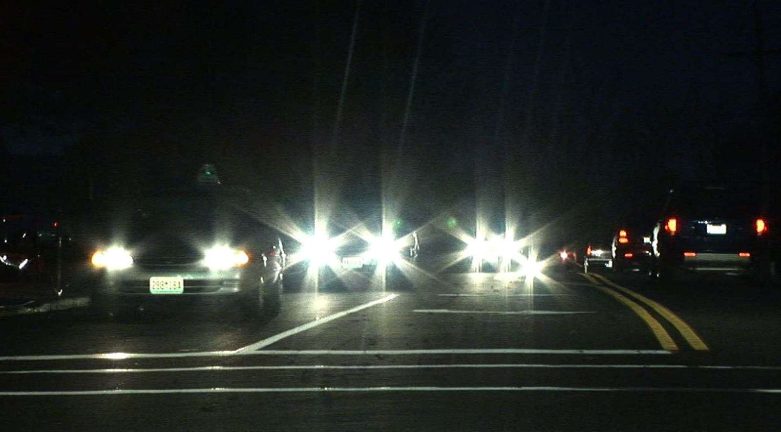
WHAT IS THE PROBLEM?
At night, on highways, the high intensity light from the
headlight of heavy vehicles blinds the oncoming bike and
car drivers for a moment . This is one of the main reasons
of highway road accidents.

Slide 3
AIM:
To avoid the effect of high intensity light from the headlight
of heavy vehicles at the night time.
OBJECTIVE:
The main objective of the project is the make the drivers
drive easily without any “glare problem”.

Slide 4
INNOVATIVE IDEA:
An automatic dim-dip system will be enabled when the
goggle’s LCD lens are darkened.
COMPONENTS:
IC LM311
Light Dependent Resistor
LED
LCD Fitted Goggle
Arduino NANO
Resistors
9V battery
Connecting wires

Slide 5
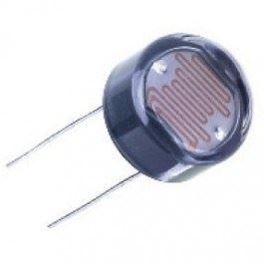
HARDWARE DESCRIPTION
LDR (Light Dependent Resistor)
An LDR is a component that has a (variable) resistance that changes with the light intensity that falls upon it. This allows them to be used in light sensing circuits. These resistors are mainly used when there is a need to sense the absence and presence of the light such as burglar alarm circuits, alarm clock, light intensity meters, etc. LDR resistors mainly involves in various electrical and electronic projects.

Slide 6
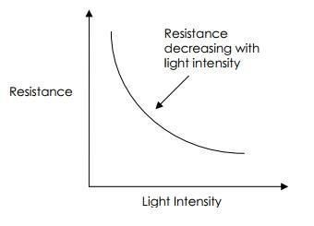
Variation in resistance with changing light intensity:
It shows that the intensity of the light directed towards LDR is inversely proportional to resistance

Slide 7
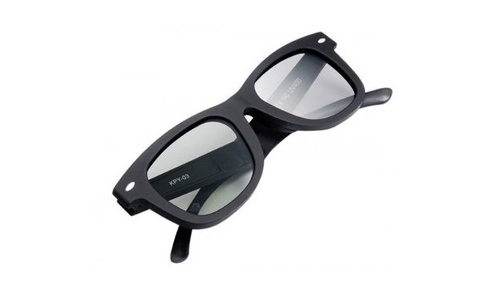
LCD fitted goggle:
It is an LCD fitted goggle which is polarized with high transmittance lenses and clearer vision. In addition, it uses UV400 lens technology for absorbing 100% of harmful UVA and UVB rays.
The principle behind the LCD’s is that when an electrical current is applied to the liquid crystal molecule, the molecule tends to untwist. This causes the angle of light which is passing through the molecule of the polarized glass and also cause a change in the angle of the top polarizing filter. As a result a little light is allowed to pass the polarized glass through a particular area of the LCD. Thus that particular area will become dark compared to other. Thus, according to the principle, when power supply is given, the LCD gets darkened.

Slide 8
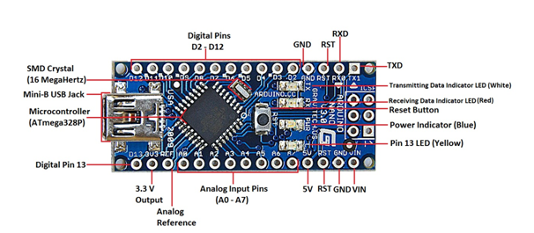
ARDUINO NANO
The Arduino Nano is a small, complete, and breadboard-friendly board based on the ATmega328P (Arduino Nano 3.x). It has more or less the same functionality of the Arduino Duemilanove, but in a different package. It lacks only a DC power jack, and works with a Mini-B USB cable instead of a standard one. The Nano was designed and is being produced by Gravitech.

Slide 9
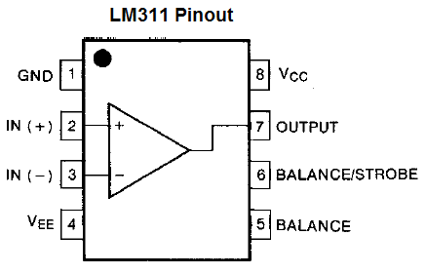
IC LM311
The LM311 Differential Comparator Op-Amp is a very old comparator IC from TI that has been used for Voltage comparisons for a long time in electronic designs.
Any Op-Amp can be made to work as a voltage comparator, but the LM311 proves itself to be advantages by housing an Output Transistor inside its package. The collector and Emitter pin of this Transistor can also be controlled by the hardware, this makes it’s suitable for many applications.

Slide 10
BLOCK DIAGRAM:
Light dependent resistor
Arduino Nano
Comparator
Automatic dim-dip system
Power supply
To LCDs
Fitted in goggle

Slide 11
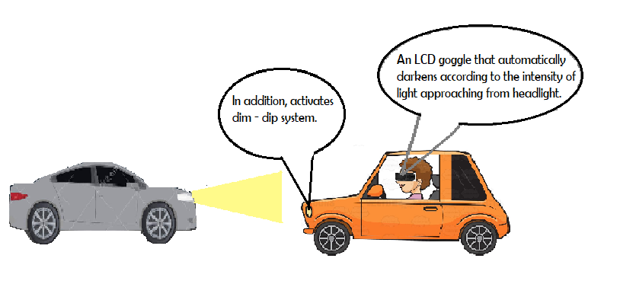
ILLUSTRATION:

Slide 12
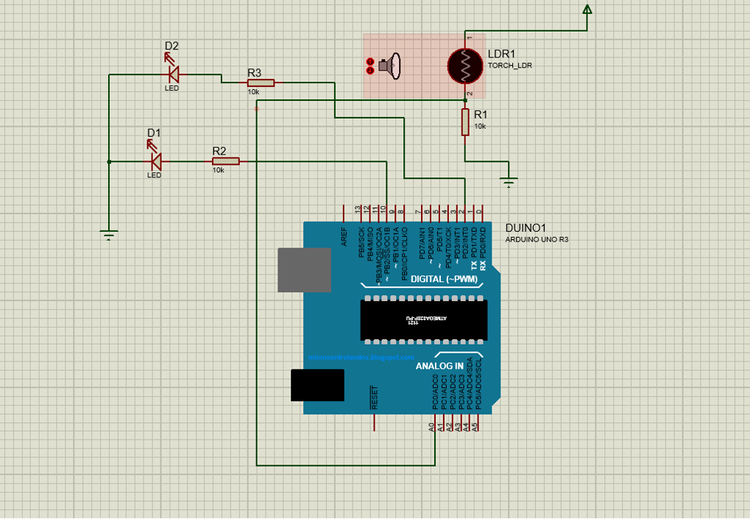
CIRCUIT DIAGRAM:

Slide 13
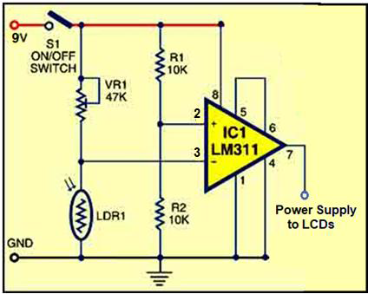

Slide 14
WORKING:
One of the analog input pins of Arduino Nano, Ao receives input from LDR sensor.
The input illuminance measured in terms of lux. When it reaches above 200, corresponding voltage is sent to one of the comparator inputs using the digital output pin 2.
IC LM311 is wired as a comparator. Its non-inverting pin3 gets reference voltage (half of the supply voltage) through divider network formed by resistors R1 and R2.
Inverting pin 2 gets the control voltage through the network of preset VR1 and light dependent resistor LDR1.
At night, the resistance of LDR1 is very high and therefore the voltage at the inverting input of IC1 remains higher than at the non-inverting input.
When light falls on LDR1, its resistance reduces.

Slide 15
As a result, the voltage at the inverting input of IC1 goes below the voltage at the non-inverting input and the resulting differential output about 3.3V enables the transparent LCD fitted in the goggle.
This enables the transparent LCDs and their colour turns black. When the light goes away, the LCDs reset within a few seconds.
Simultaneously, when the Arduino NANO reads value more than 200(higher light intensity) from LDR analog sensor pin, it sends the output to LEDs through digital output pin 10.
The LEDs (automatic dim-dip system) starts blinking with sufficient delay.

Slide 16
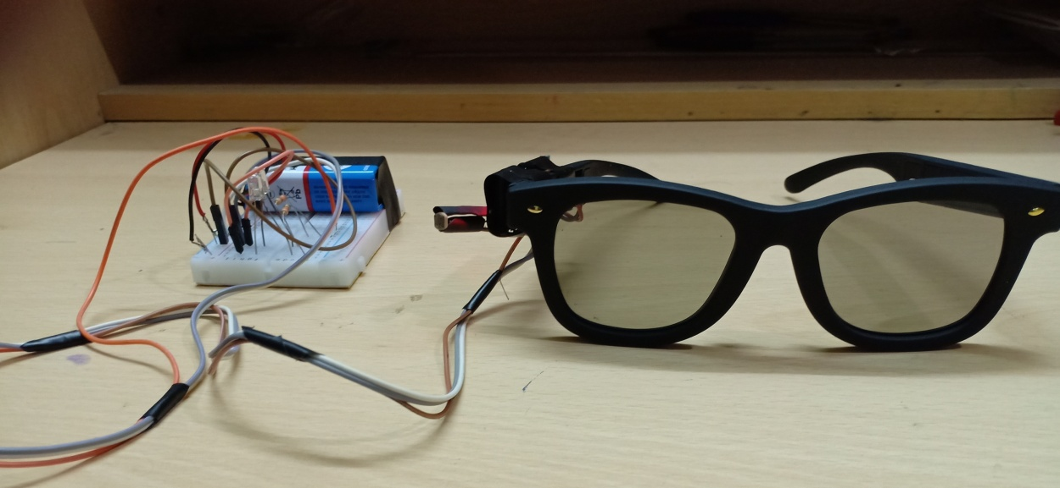
OPERATIONAL PROCEDURE:
The connections are given as per the circuit diagram. The below picture is in normal condition with low light intensity.

Slide 17
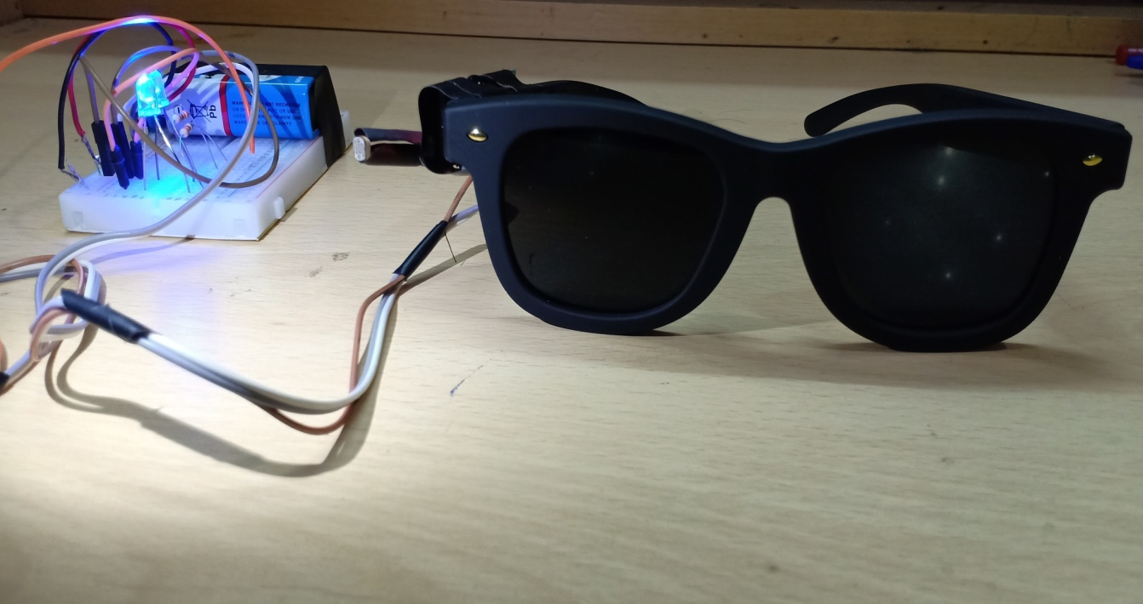
The below picture is the condition with high light intensity. This reduces the effective resistance which leads to power supply to LCDs. This results in darkening of the LCD lenses. This leads to the blinking of the prototype of “the automatic dim-dip system” incorporated using ArduinoNANO.

Slide 18
ADVANTAGES
This digital anti-glare goggle avoids accidents due to blurred vision.
The automatic dim-dip system indicates our presence and also can act as a pass light.
LIMITATIONS
LCD fitted goggles are difficult to fabricate and hence are bit costlier.
These goggles must be handled with care due to the LCD lenses.

Slide 19
APPLICATIONS
It can be used by bike and car drivers while driving to avoid
glare problem.
It can also be incorporated in helmets of bike riders for
convenience.
FUTURE SCOPES
This has a lot of commercial value as it reduces the accident rate. Some efficient fabrication method would make these goggles cheaper and hence more production.
REFERENCE
www.wikipedia.com
www.arduino.com
www.electronicsforu.com

Slide 20
THE END

